Slide 1
No Silver Bullet – Essence and Accident in Software Engineering
Mike Ballou

Slide 2
“There is no single development, in either technology or management technique, which by itself promises even one order-of-magnitude improvement within a decade in productivity, in reliability, in simplicity.”

Slide 3
Abstract
“All software construction involves essential tasks, the fashioning of the complex conceptual structures that compose the abstract software entity, and accidental tasks, the representation of the abstract entities in programming languages and the mapping of these onto machine languages within space and speed constraints.”

Slide 4
Abstract
“Most of the big gains in software productivity have come from removing artificial barriers that have made the accidental tasks inordinately hard, such as severe hardware constraints, awkward programming languages, lack of machine time. How much of what software engineers now do is still devoted to the accidental, as opposed to the essential?”

Slide 5
Agile Abstract
“Therefore it appears that the time has come to address the essential parts of the software task, those concerned with fashioning abstract conceptual structures of great complexity. I suggest:
Using rapid prototyping as part of a planned iteration in establishing software requirements
Growing software organically, adding more and more functions to systems as they are run, used, and tested”

Slide 6

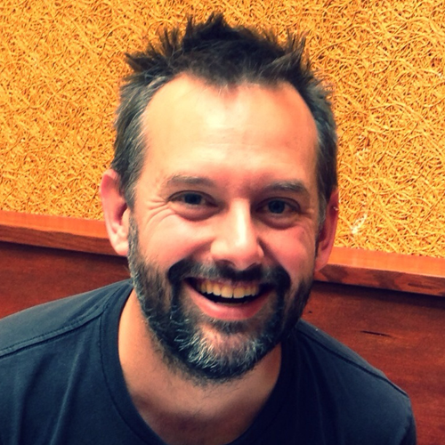
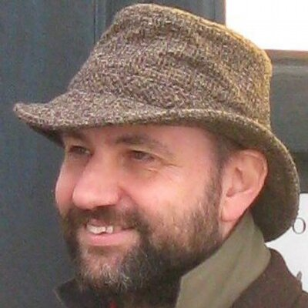
Who said it?

Slide 7
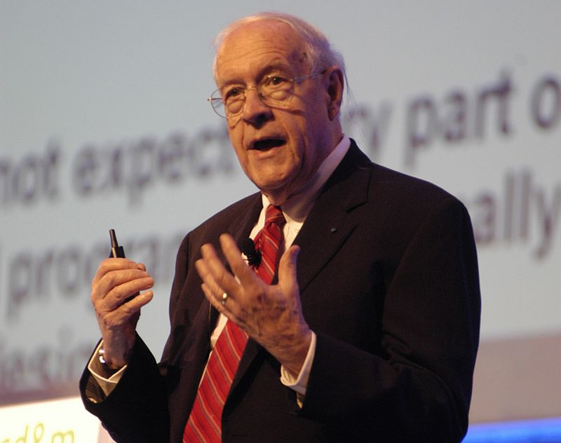
Frederick Brooks Jr.
Joined IBM in 1956
Manager for the development of the IBM System/360 family of computers and the OS/360 software package
In 1975, published The Mythical Man-Month: Essays on Software Engineering
In 1987, authored No Silver Bullet – Essence and Accident in Software Engineering

Slide 8

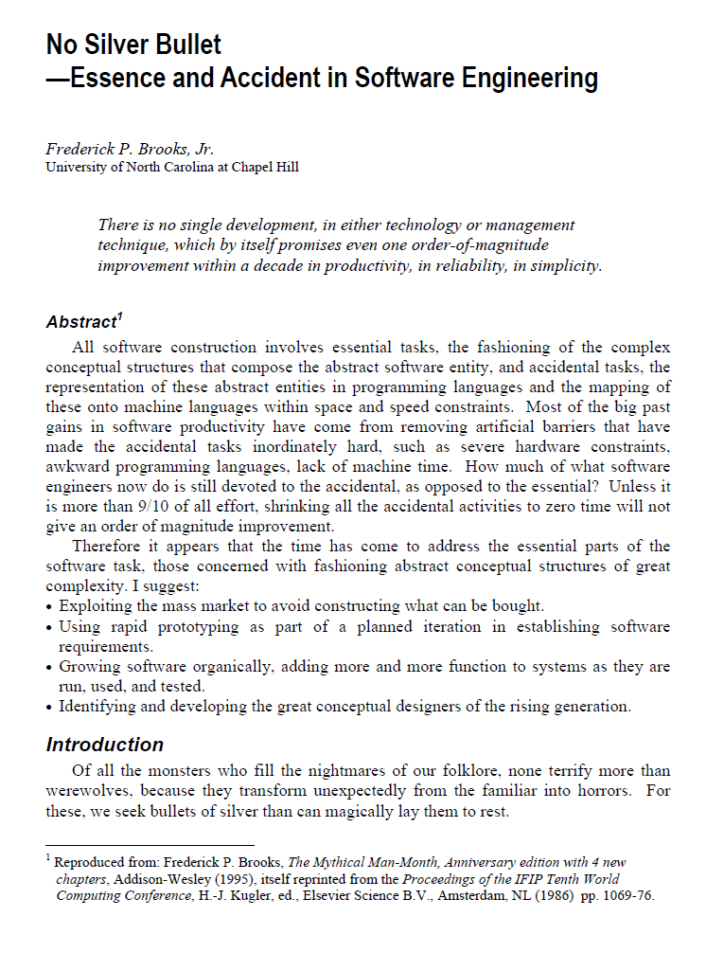

Slide 9
“We hear desperate cries for a silver bullet – something to make software costs drop as rapidly as computer hardware costs do…. Not only are there no silver bullets now in view, the very nature of software makes it unlikely that there will be any.”

Slide 10
Sources of Essential Difficulty

Slide 11
“Let us consider the inherent properties of this irreducible essence of modern software systems: complexity, conformity, changeability, and invisibility.”

Slide 12
Complexity
Software entities are more complex for their size than perhaps any other human construct, because no two parts are alike
The complexity of software is an essential property, not an accidental one
Descriptions of a software entity that abstract away its complexity often abstract away its essence
Not only technical problems but management problems as well comes from the complexity
It creates the tremendous learning and understanding burden that makes personnel turnover a disaster

Slide 13
Conformity
Software people are not alone in facing complexity
Physics deals with terribly complex objects even at the fundamental level, but
Einstein argued there must simplified explanations, because nature is not capricious or arbitrary
No such faith comforts the software engineer
Software must conform because it is perceived as the most conformable

Slide 14
Changeability
The software entity is constantly subject to pressures for change
All successful software gets changed, and successful software survives beyond the normal life of the machine for which it is first written
Software is embedded in a cultural matrix of applications, users, laws, and machine vehicles

Slide 15
Invisibility
Software is invisible and unvisualizable
Our minds are deprived of some of its most powerful conceptual tools
This lack not only impedes the process of design within one mind, it severely hinders communication among minds

Slide 16
Past Breakthroughs Solved Accidental Difficulties

Slide 17
“If we examine the three steps in software technology that have been most fruitful in the past, we discover that each attacked a different major difficulty in building software, but they have been the accidental, not the essential, difficulties.”

Slide 18
Solutions to Accidental Difficulties
High-level languages
The most a high-level language can do is to furnish all the constructs the programmer imagines in the abstract program
Time-sharing
Preserves immediacy, and hence enables us to maintain an overview of complexity
Unified programming environment
They attack the accidental difficulties of using tools together

Slide 19
Hopes for the Silver

Slide 20
“Now let us consider the technical developments that are most often advanced as potential silver bullets. Are they the problems of essence, or are they remainders of our accidental difficulties?”

Slide 21
Silver bullets?
Ada and other high-level language advances
Object-oriented programming
Artificial intelligence
Expert systems
“Automatic” programming
Graphical programming
Program verification
Environments and tools
Workstations

Slide 22
“Automatic” programming (MBSE?)
For almost 40 years (from 1995), people have been writing about the generation of a program for solving a problem from a statement of the problem specifications
The term is used for glamour and not semantic content, automatic programming has always been a euphemism for programming with a higher-level language than was presently available to the programmer
In essence, it is the solution method, not the problem, whose specification has to be given

Slide 23
Program verification
Program verification does not mean error-proof programs
There is no magic here either, mathematical proofs can be faulty
Even perfect program validation can only establish that a program meets its specification, the hardest part of the software task is arriving at a complete and consistent specification

Slide 24
Environments and tools
How much more gain can be expected from the exploding researches into better programming environments?
Surely this work is worthwhile, and surely it will bear some fruit in both productivity and reliability
But by its very nature, the return from now on must be marginal

Slide 25
Promising Attacks on the Conceptual Essence

Slide 26
“Even though no technological breakthrough promises to give the sort of magical results with which we are so familiar in the hardware area, we must consider those attacks which address the essence of the software problem, the formulation of these complex conceptual structures”

Slide 27
Attack the essence of the software problem
Buy versus build
Requirements refinement and rapid prototyping
Incremental development – grow, not build, software
Great designers

Slide 28
Requirements refinement and rapid prototyping
The hardest single part of building a software system is deciding precisely what to build
The most important function that software builders do for their clients is the iterative extraction and refinement of the product requirements
Much of present-day software acquisition procedures rests upon the assumption that one can specify a satisfactory system in advance, get bids for its construction, have it built, and install it
This assumption is fundamentally wrong, and that many software acquisition problems spring from that fallacy
Hence they cannot be fixed without fundamental revision, one that provides for iterative development and specification of prototypes and products

Slide 29
Incremental development – grow, not build, software
Let us turn to nature and study the complexity in living things
The brain alone is intricate beyond mapping, powerful beyond imitation
The secret is that it is grown, not built
So it must be with our software systems
The system should first be made to run, even though it does nothing useful
Bit-by-bit it is fleshed out
The morale effects are startling
Enthusiasm jumps when there is a running system, even a simple one
One always has, at ever stage in the process, a working system

Slide 30
Conclusion

Slide 31
Essential Complexity vs. Accidental Complexity
Essential Complexity
The fundamental problem you are trying to solve, the customer’s mission
The essential nature of software
Accidental Complexity
Programming languages
Environments and tools

Slide 32

A Modern Take on Accidental Complexity
Yak Shaving - the phenomenon where one task leads to another, which leads to another, until you end up working on something that seems completely unrelated to the original problem

Slide 33
Example of Yak Shaving
“My client needed a simple wiki, but before I can help them I need…”
to Containerize the software, but to run that I need…
a Container Management Platform, but to network it I need…
a Service Mesh, but to secure it I need…
an automated Certificate Authority, and for more security I need…
a Container scanning and monitoring service, and to monitor it more I need…
a Log Aggregation and Search service, but to install it I need…
root access on a bunch of servers, but I need more servers so I need…
an Infrastructure as a Service platform, but for high availability I need…
another rack of servers, but to pay for it I need…

Slide 34
Always ask yourself
Am I solving my customer’s essential problem?
Or am I just shaving a yak?

Slide 35
Brook’s Advice
The system should first be made to run
Bit-by-bit it is fleshed out
One always has, at every stage in the process, a working system
Enthusiasm jumps when there is a running system, even a simple one

